Slide 1
Java Basics 12
Guangjian Zhou

Slide 2
Can the default web server in the Spring Boot application be disabled?
The easiest way to prevent a Spring Boot application from starting an embedded web server is to not include the web server starter in our dependencies. This means not including the spring-boot-starter-web dependency in either the Maven POM or Gradle build file.
spring.main.web-application-type=NONE

Slide 3
What are the uses of @RequestMapping and @RestController annotations in Spring Boot?
@RequestMapping nnotation for mapping web requests onto methods in request-handling classes with flexible method signatures.
Indicates that an annotated class is a "Controller" (e.g. a web controller), allowing for implementation classes to be autodetected through classpath scanning. A convenience annotation that is itself annotated with @Controller and @ResponseBody.

Slide 4
What is Spring AOP?
Aspect-Oriented Programming (AOP) is one of the key elements of the Spring Framework. AOP praises Object-Oriented Programming in such a way that it also provides modularity. But the key point of modularity is the aspect than the class. AOP breaks the program logic into separate parts called concerns. The functions that span multiple points of a web application are named cross-cutting concerns and these cross-cutting concerns are conceptually separate from the application's business logic. AOP aims to increase modularity by allowing the separation of cross-cutting concerns.

Slide 5
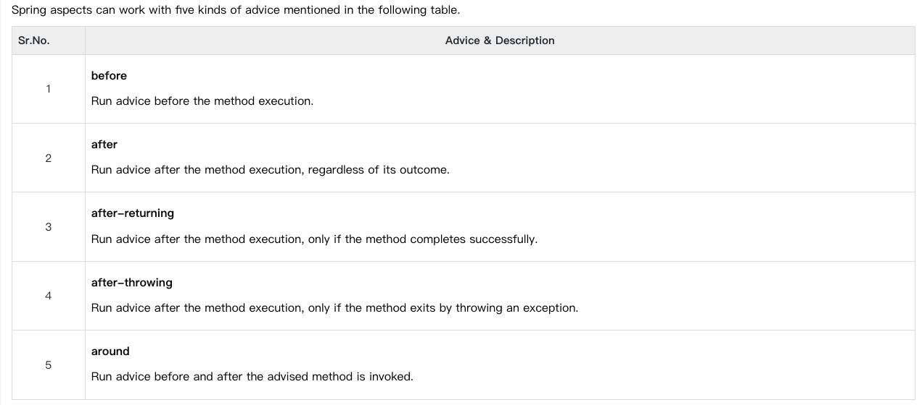
What is an advice? Explain its types in spring.
Advice: The advice is an action that we take either before or after the method execution.
The action is a piece of code that invokes during the program execution.
There are five types of advices in the Spring AOP framework: before, after, after-returning, after-throwing,
and around advice.

Slide 6
What is Spring AOP Proxy pattern?
AOP proxy: an object created by the AOP framework in order to implement the aspect contracts (advise method executions and so on). In the Spring Framework, an AOP proxy will be a JDK dynamic proxy or a CGLIB proxy.
The Proxy pattern uses a proxy (surrogate) object “in place of” another object. The objective of a proxy object is to control the creation of and access to the real object it represents. A common use of a proxy is to defer the cost of instantiating of an object (that is expensive to create) until it is actually needed by clients.

Slide 7
What are some of the classes for Spring JDBC API?
In this tutorial, we'll go through practical use cases of the Spring JDBC module.
All the classes in Spring JDBC are divided into four separate packages:
core — the core functionality of JDBC. Some of the important classes under this package include JdbcTemplate, SimpleJdbcInsert, SimpleJdbcCall and NamedParameterJdbcTemplate.
datasource — utility classes to access a data source. It also has various data source implementations for testing JDBC code outside the Jakarta EE container.
object — DB access in an object-oriented manner. It allows running queries and returning the results as a business object. It also maps the query results between the columns and properties of business objects.
support — support classes for classes under core and object packages, e.g., provides the SQLException translation functionality

Slide 8
How can you fetch records by Spring JdbcTemplate?
String selectQuery = "select * from Student"; List <Student> students = jdbcTemplateObject.query(selectQuery, new StudentMapper());

Slide 9
What is Hibernate ORM Framework?
Hibernate ORM (or simply Hibernate) is an object–relational mapping tool for the Java programming language. It provides a framework for mapping an object-oriented domain model to a relational database. Hibernate handles object–relational impedance mismatch problems by replacing direct, persistent database accesses with high-level object handling functions.

Slide 10
What are the two ways of accessing Hibernate by using Spring.
There are two approaches to Spring's Hibernate integration:
Inversion of Control with a HibernateTemplate and Callback.
Extending HibernateDaoSupport and Applying an AOP Interceptor.

Slide 11
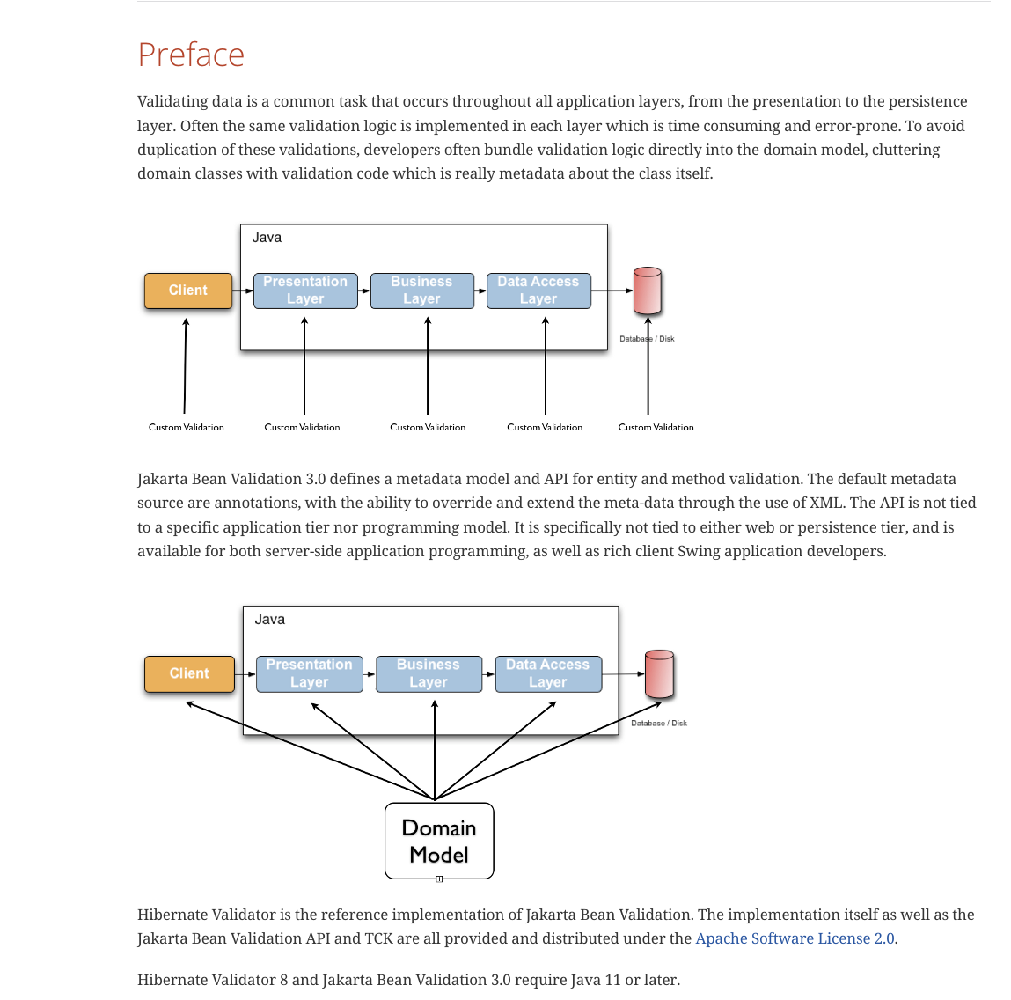
What is Hibernate Validator Framework?

Slide 12
What is Hibernate Template class?
HibernateTemplate is a helper class which provides different methods for querying/retrieving data from the database. It also converts checked HibernateExceptions into unchecked DataAccessExceptions. HibernateTemplate benefits : HibernateTemplate simplifies interactions with Hibernate Session.

Slide 13
What is the Spring MVC framework?
Spring MVC is a Java framework that is used to develop web applications. It is built on a Model-View-Controller (MVC) pattern and possesses all the basic features of a spring framework, such as Dependency Injection, Inversion of Control.

Slide 14
What are the benefits of Spring MVC framework over other MVC frameworks?
Spring MVC Benefits
Spring MVC shines when it comes to:
Promoting separation of concerns - it's great way to develop modular web applications
Abstracts away the tedious and boilerplate tasks of handling HTTP requests
Excellent support for developing RESTful web services
Both Spring Boot and Spring MVC bring unique advantages yet have the same goal of faster, more efficient development. Consider using them together for your web application.

Slide 15
What is DispatcherServlet in Spring MVC? In other words, can you explain the Spring MVC architecture?
The DispatcherServlet is the front controller in Spring web applications. It's used to create web applications and REST services in Spring MVC. In a traditional Spring web application, this servlet is defined in the web. xml file.

Slide 16
What is a View Resolver pattern and explain its significance in Spring MVC?
All MVC frameworks provide a way of working with views. Spring does that via the view resolvers, which enable you to render models in the browser without tying the implementation to a specific view technology. The ViewResolver maps view names to actual views.

Slide 17
What is the @Controller annotation used for?
The basic purpose of the @Controller annotation is to act as a stereotype for the annotated class, indicating its role. The dispatcher will scan such annotated classes for mapped methods, detecting @RequestMapping annotations (see the next section).

